Slide 1
medical diagnosis
Directed to: Dr. Mohamed El Hamahmy
Presented by:
kareem mohamed
Ahmed wael
Ahmed mohamed

Slide 2
Project definition:
The problem we are trying to solve is to decrease the miss diagnosis prediction that can cause a lot of trouble as taking a medicine that is not for the right disease.
We are solving it by making an AI program that can predict with your symptoms if you have the disease that you think you have.
This program is designed for the people to use to predict there problem if they can’t go to the doctor soon enough from any place , so it will help them knowing what they may have until they see a doctor and make sure of it.
The program will achieve that by training our machine to learn and test it’s knowledge .
By doing that We will decrease the miss usages of medicines .
This problem is a classification problem ,it’s output is a positive or negative for the patient guess .

Slide 3
Dataset :
The data set we choose have inputs of:
The disease you want to check about.
If you have a fever or not
If you are coughing or not
If you have a fatigue or not
Difficulty breathing
The age of the patient
The gender
How is his blood pressure?
The cholesterol

Slide 4
These are the dataset inputs most of them are a yes or no question to make it easier for the user and the machine.
The dataset output is: Is a positive or negative text to tell him if he has the disease he suspects or not.
After trying the Naïve bayes and neural network models
We found that the neural network model has better accuracy than naïve bayes in our dataset.

Slide 5

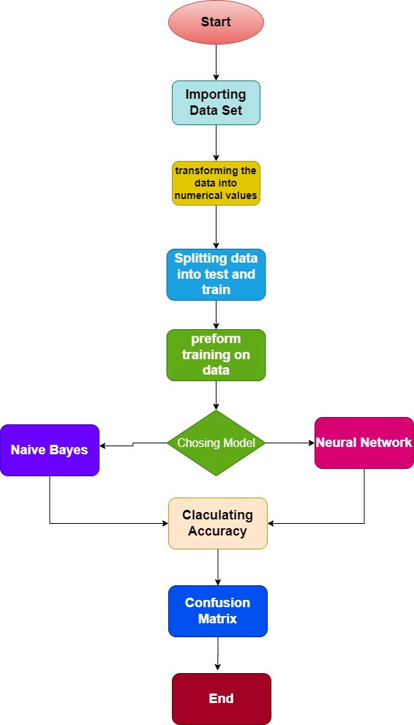

Slide 6
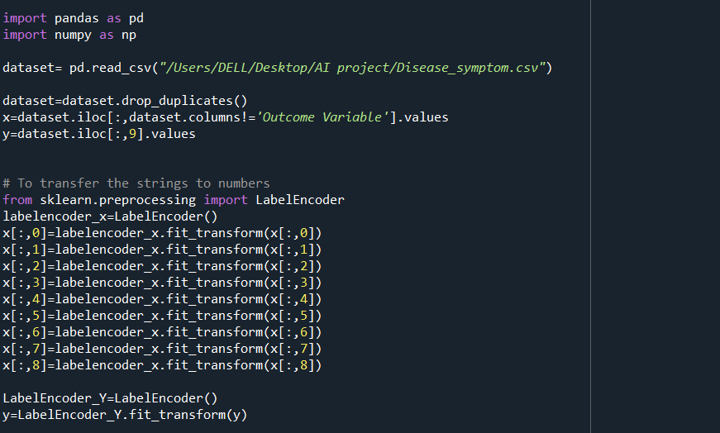

Slide 7
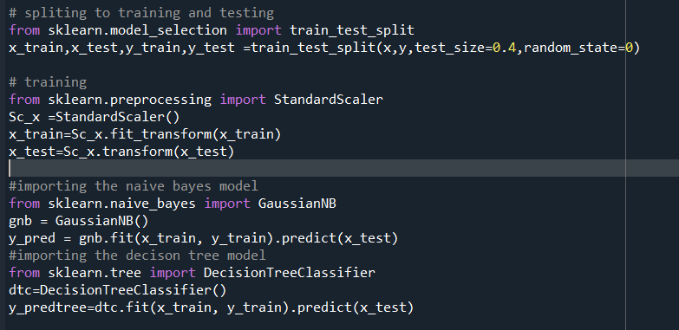
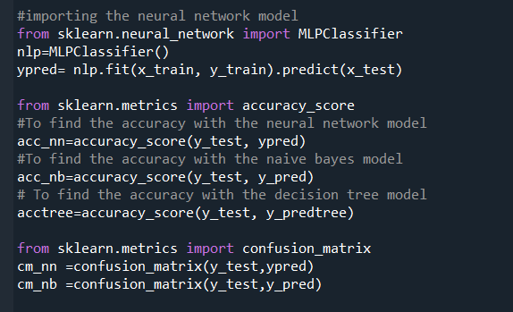

Slide 8

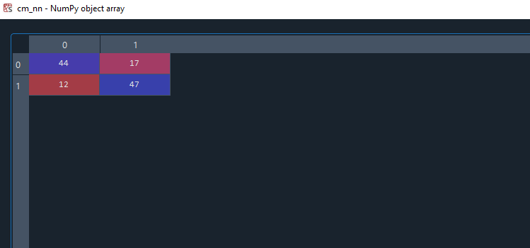
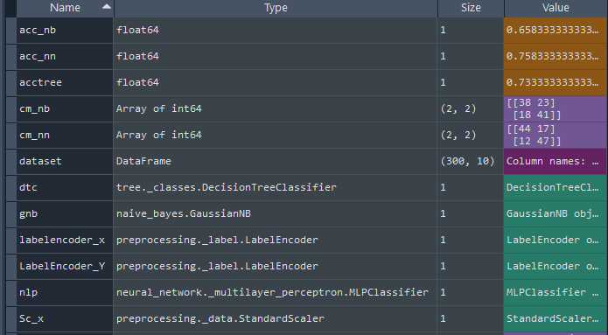

Slide 9
THANK YOU

